Slide 1
INTRODUCTION
NAME- ARZOO
ROLL NO- 229194
COURSE- BCA
PROJECT – TECH HUB STUDY

Slide 2

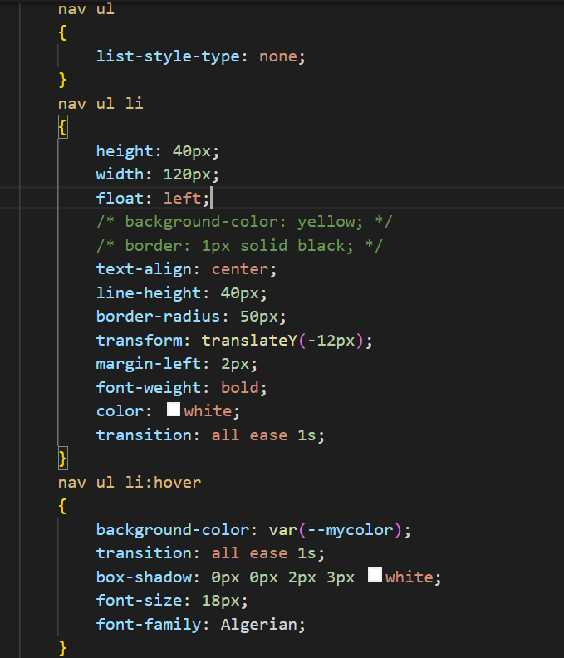
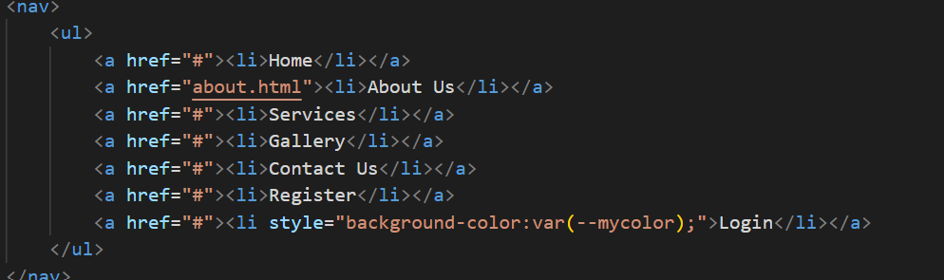
NAVIGATION
HTML AND CSS

Slide 3

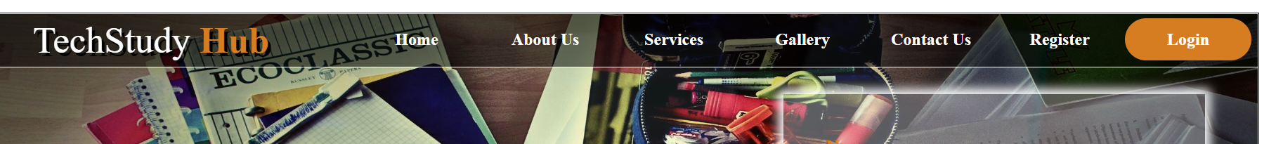
OUTPUT

Slide 5
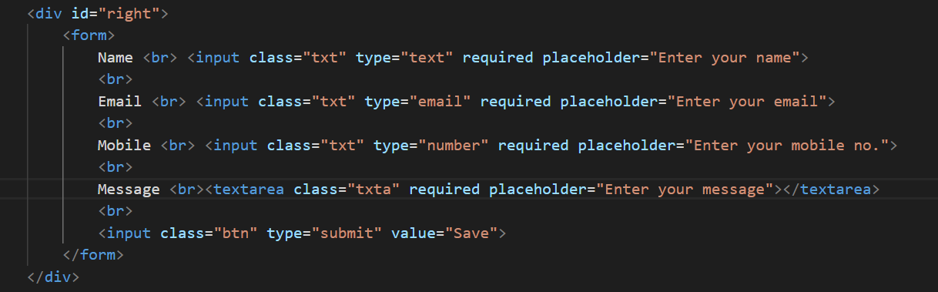
CONTACT FORM

Slide 6
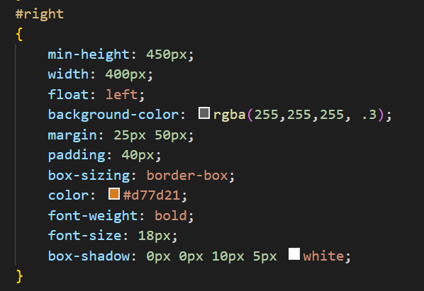
STYLE USED

Slide 7
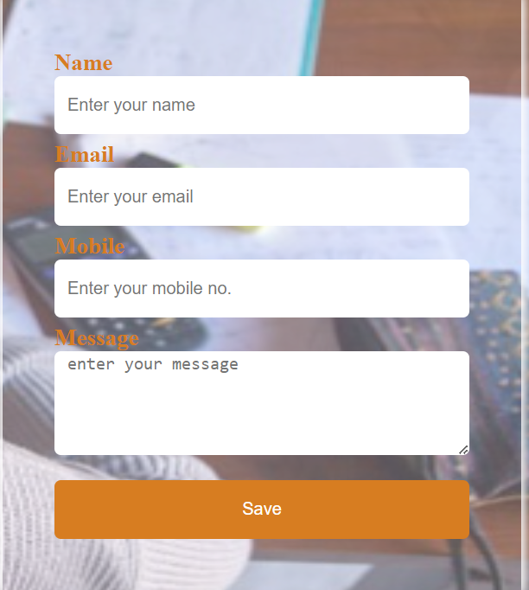
OUTPUT

Slide 8

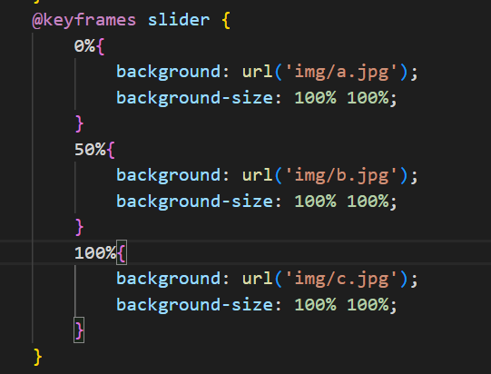


TRANSITION

Slide 9
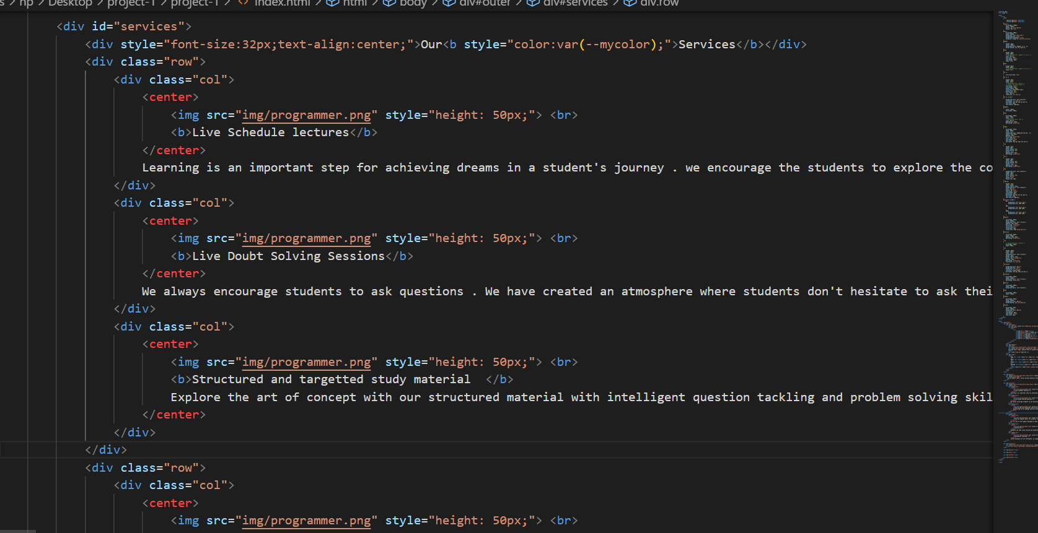
FOOTER

Slide 10
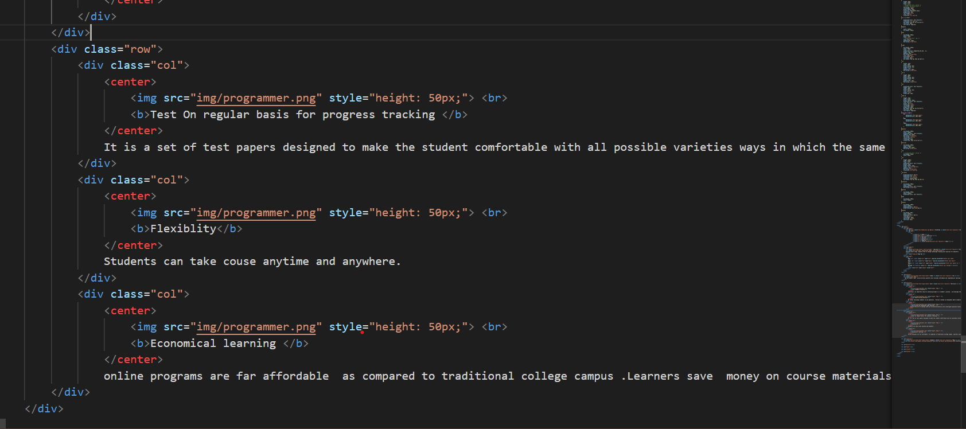

Slide 11
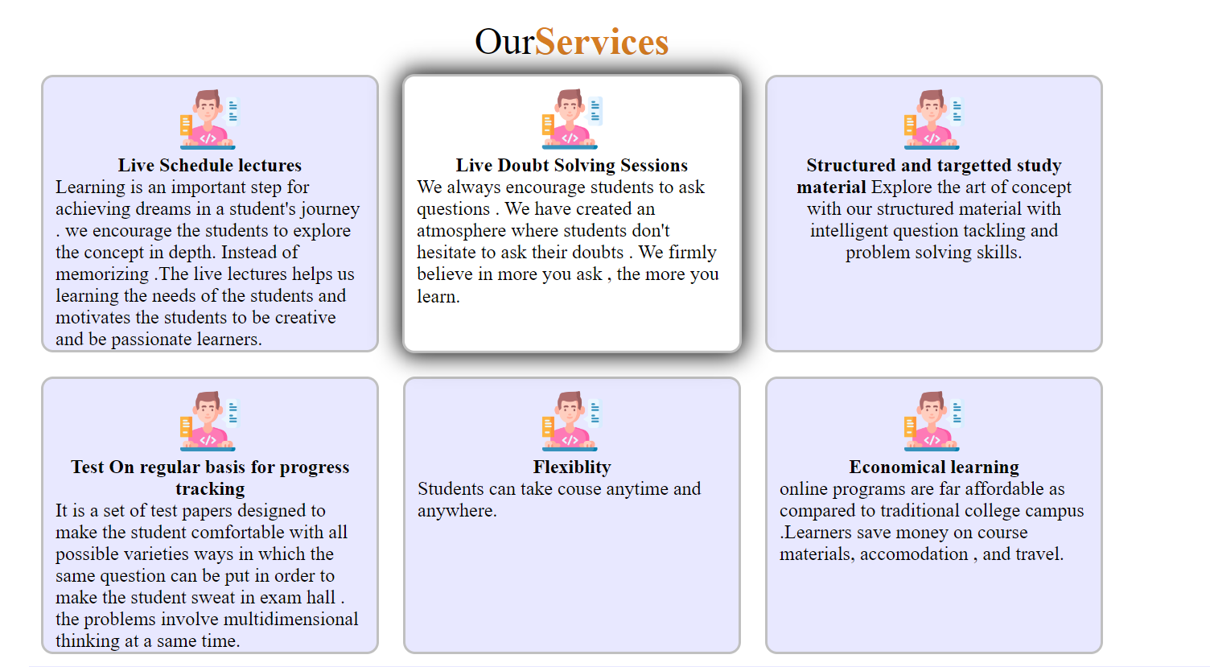
OUTPUT

Slide 12
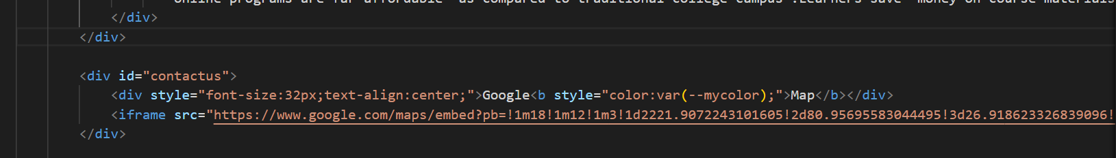
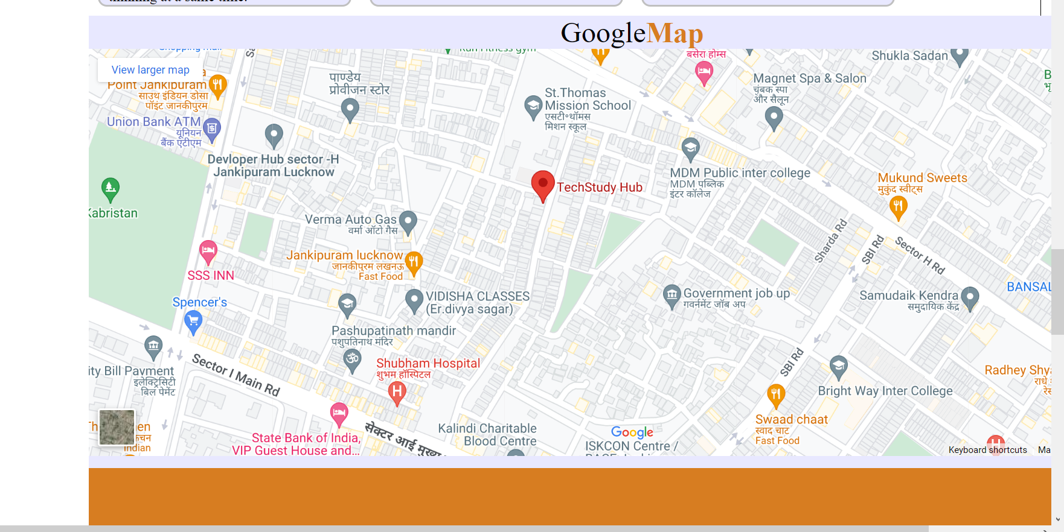
HTML AND CSS
OUTPUT

Slide 13
THANK YOU

